Slide 1


Slide 2
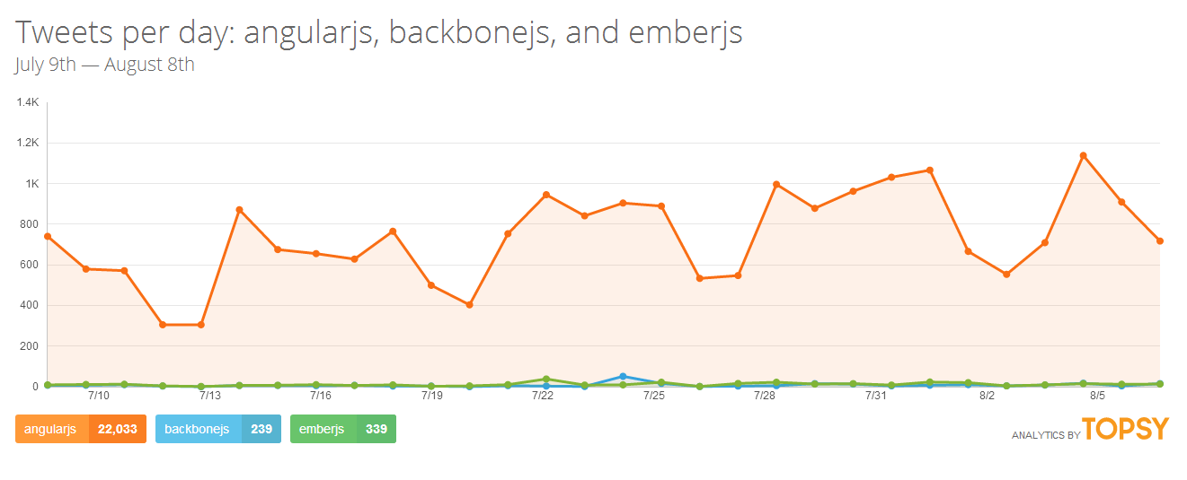
Angular : The Celebrity

Slide 3


Slide 4

Aww… Crap…..
Still in Alpha

Slide 5
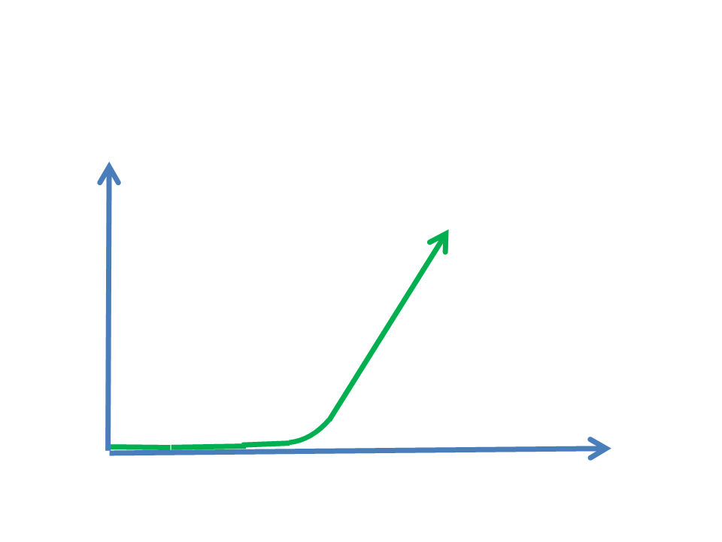

Steep Leaning Curve

Slide 6



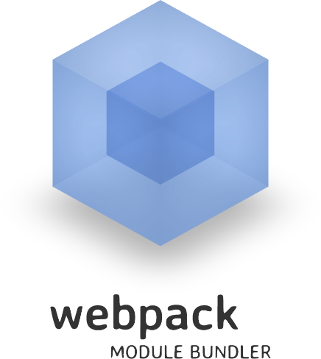

Part of the Curve
ES6/Typescript
Decorators
Module Loaders (SystemJs/Webpack)
Web Components
Data Architecture using Observables
Reactive Programming (RxJs)
DOM
Zone Js (not covered)

Slide 7



The ‘Moment’

Slide 8
WebComponents.org
A standard for Web Components
Encapsulation and Reusability
Specifications
Create Custom HTML Elements
Import of one HTML documents into another
Define templates (HTML fragments)
Shadow DOM for better encapsulation

Slide 9
Web Components
Custom Elements - Enables the extension of HTML through custom tags.
HTML Imports - Enables packaging of various resources (HTML, CSS, JS, etc.).
Template Element - Enables the inclusion of inert HTML in a document.
Shadow DOM - Enables encapsulation of DOM and CSS.
It's worth trying these things out with Polymer or X-Tag. They're projects that polyfill Web Components so we can use them as they're planned, today.

Slide 10
As Angular Team describes it:
“By combining these four capabilities web developers can create declarative components (Custom Elements) which are fully encapsulated (Shadow DOM). These components can describe their own views (Template Element) and can be easily packaged for distribution to other developers (HTML Imports).”

Slide 11
JavaScript.next
Next version is ECMASrcipt 6 (JS2015)
What you wished is what you get
Classes
Arrow functions (lambdas)
Module System
…and other features

Slide 12
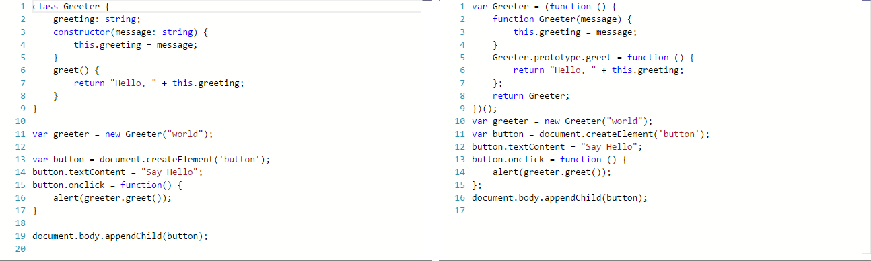


TypeScript
TypeScript is a typed superset of JavaScript that compiles to plain JavaScript.

Slide 13
Decorators
ES6 + Annotations + Types = AtScript
Microsoft + Google = TypeScript + AtScript

Slide 14

Lets “Hello World” ;)

Slide 15

What are the differences between Angular 1.x and Angular 2.0?
Why should I go to Angular 2.0 if I am a Angular 1.x developer?
How to move the application from Angular 1.x to 2.0?
What are the best practices to move from Angular 1.x to 2.0?
How to go around the data architecture of Angular 2.0 application?
How to scale up the entire Angular 2.0 learning curve?

Slide 16
Differences between Angular 1.x and 2.0
$scope replaced by ES6 classes.
No standalone controllers.
DOM events.
No more ng-click, ng-mouseover, etc..
Modular Application Architecture.
New Router (not covered).
Truck load of new core services

Slide 17
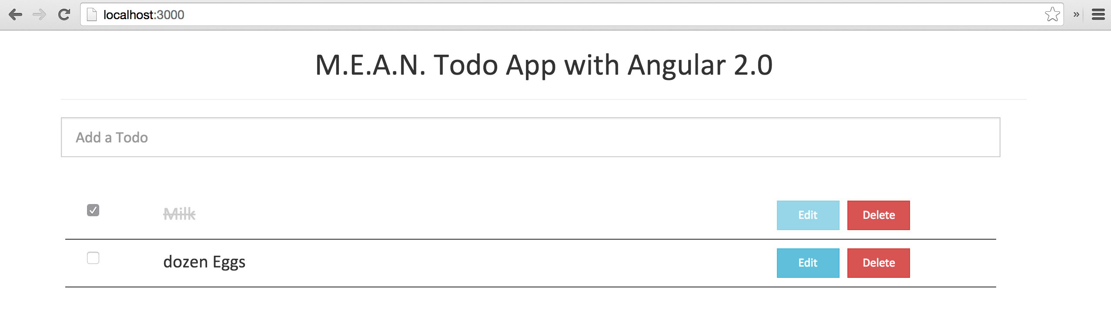
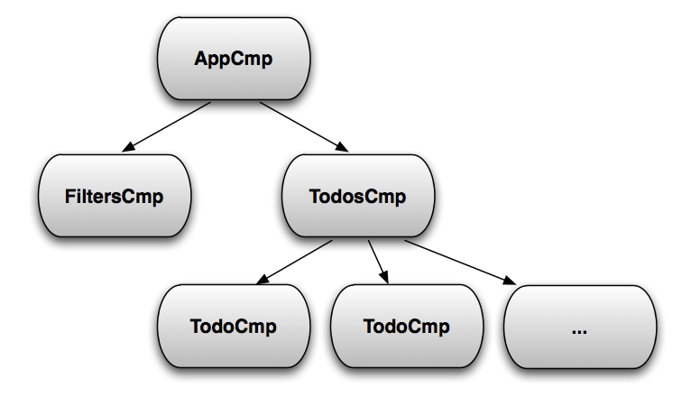
Component Tree

Slide 18


Lets look at an Angular 2.0 starter application (!To-do) :
Tree of components.
Written in TypeScript.
Uses SystemJs for module loading.
Composition of components.
Dependency Injection
Bootstarping
https://github.com/pragyandas/Angular2-Starter-App

Slide 19
Best Practices to move from 1.x to 2.0
Avoid
$scope
$scope
$scope
The link function
No Standalone Controllers
$parse, $observe, $eval
Embrace
Isolated Scope Directives
ControllerAs
BindToController
ES6 classes

Slide 20
Components: 2.0 and 1.x

Slide 21
Why from 1.x to 2.0 ?
Mobile, Modular, Modern…
“AngularJS 1.x is built for current browsers while AngularJS 2.0 is being built for the bowsers of the future.”
Igor Minaz, Angular JS Team

Slide 22
Template Syntax / DOM
No more jqLite.
No more ng-click, ng-mousedown, ng-blur, etc.
No more ng-show, ng-hide, ng-disabled, etc.
Relied directly on the DOM.

Slide 23
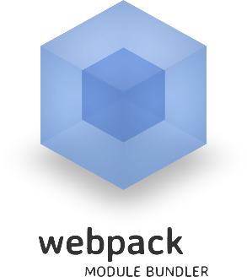
Lets go back to the same application but
Using Webpack
Using Webpack for bundling TypeScript files to JavaScript bundles.
Using Webpack for module loading.
DOM events.
https://github.com/pragyandas/Angular2-Webpack-Starter-Application

Slide 24
DATA ARCHITECTURE

Slide 25


Reactive Functional Programming (RxJs)
Observer Pattern + Iterator Pattern

Slide 26
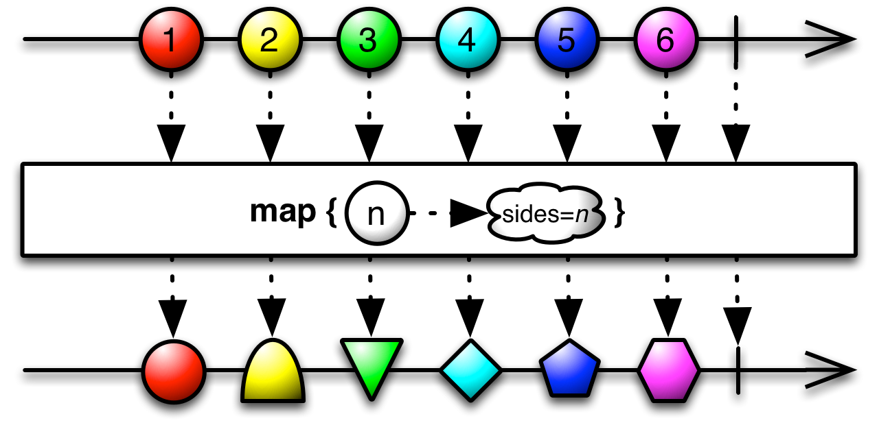
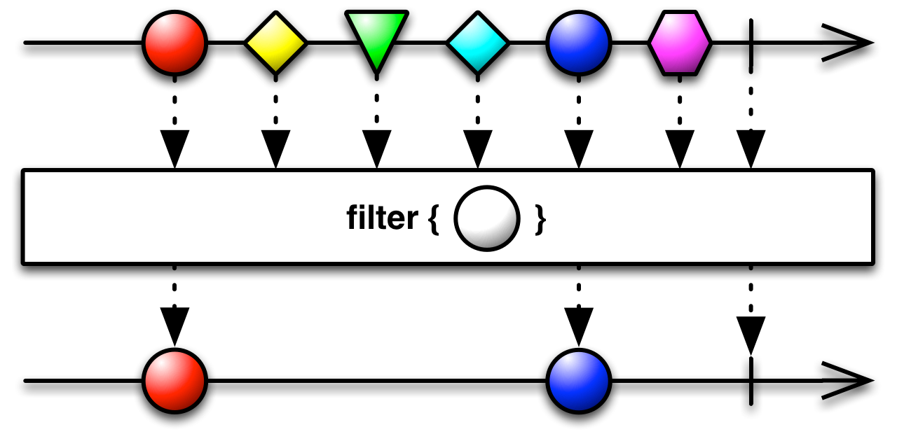
Functional Programming
map
filter
mergeAll
reduce
zip
http://robdodson.me/javascript-design-patterns-iterator/

Slide 27
Reactive Programming
Observables
Observers
Added Benefits
Async Error Handling.
Better than Promises.
Auto Disposal on stream completion.
Exposes disposable method for manual disposal.
& a lot more…
http://www.dofactory.com/javascript/observer-design-pattern

Slide 28
Push vs Pull
 | Single Return value | Multiple return values
Pull/Synchronous/Interactive | Object | Iterables (Array | Set | Map | Object)
Push/Asynchronous/Reactive | Promise | Observable

Slide 29
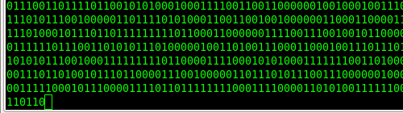

Both are exactly the same.
How?
https://github.com/pragyandas/Rx-Event-Data

Slide 30
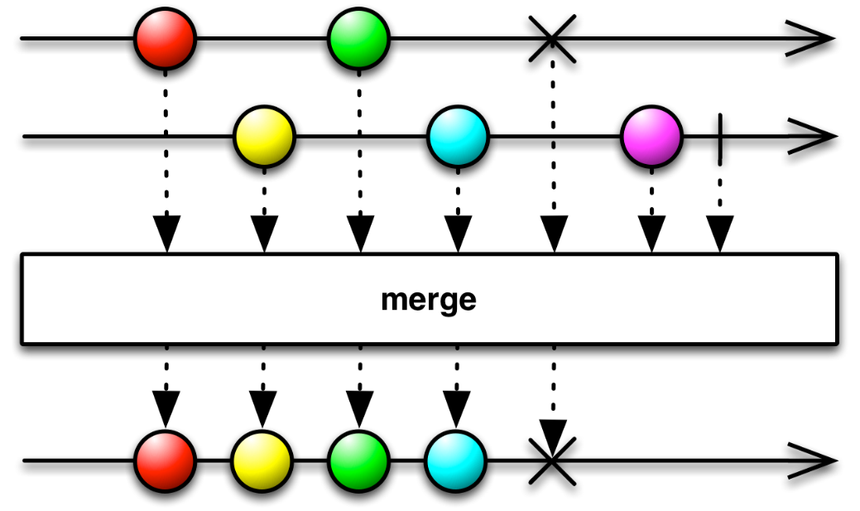
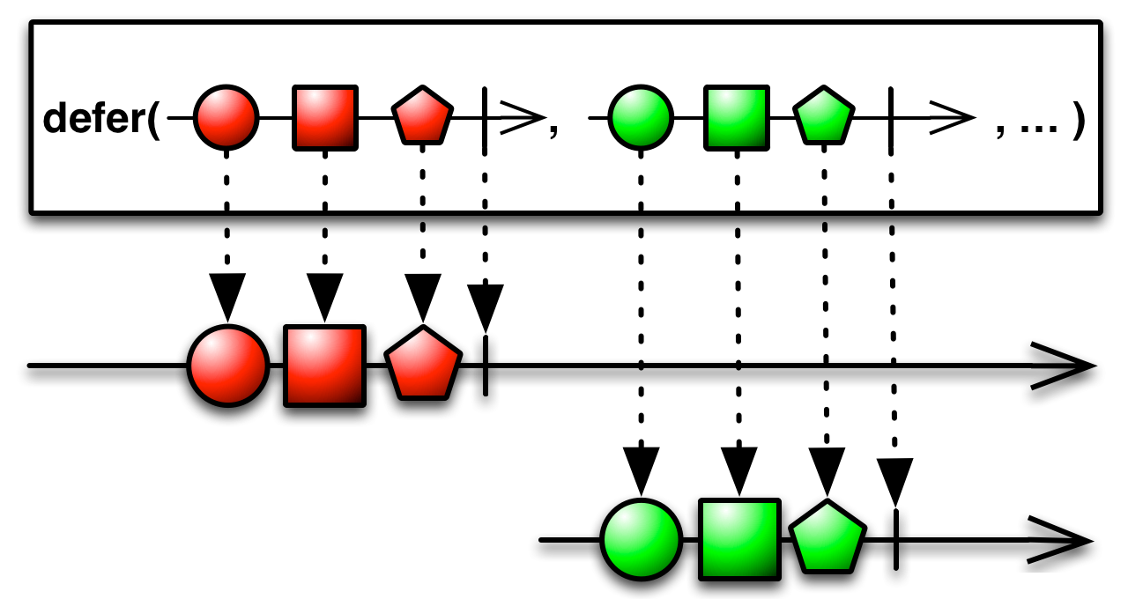
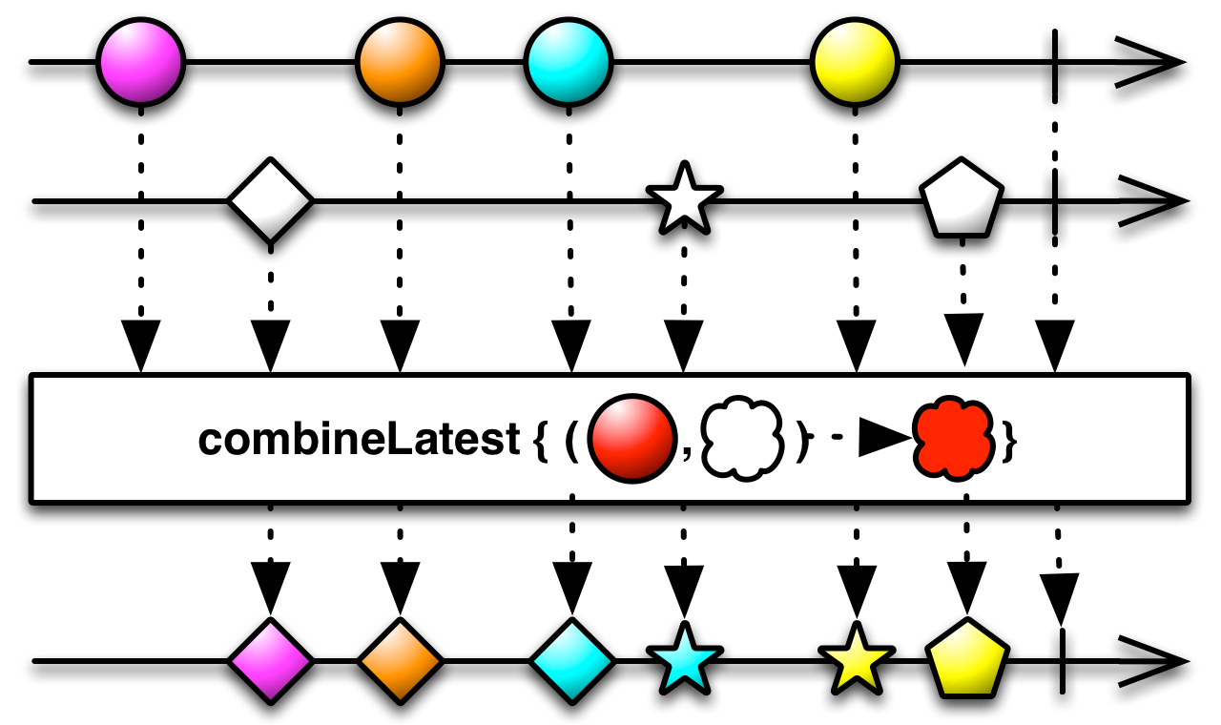
Ridiculous number of operators:
and more…

Slide 31
Search Service using RxJs
Creating Rx Observable from Wikipedia API.
Subscribing to the Observable.
Showcase some new RxJs operators.

Slide 32
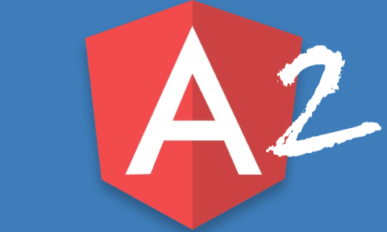
RxJs and AngularJS 2.0
+
Let’s look into the data architecture…

Slide 33
